Slide 1
MLB Pitching Regression Analysis
Andrew Floyd, Charlie Duvall, David Gillcrist, Raylynn Swift

Slide 2
Background
We decided to look at the effect of different baseball team pitching statistics has on winning.
Statistics and analytics are at the forefront of modern baseball and is used by every organization in Major League Baseball (MLB).
Our goal was to determine which pitching statistics (if any) have the largest impact on a team’s record.

Slide 3
Data
We obtained our data from baseball-reference.com, where we used the Standard Team Pitching Statistics from both the 2016 and 2017 seasons.
With 30 teams (in MLB) over two seasons, this gave us 60 observations (n=60).
Response Variable = Wins (W)

Slide 4
Data
Quantitative Explanatory Variables:
ERA (Earned Run Average) : # of runs a team gives up per nine innings (one game).
SO (Strikeouts): # of strikeouts all of the team’s pitchers had.
SV (Saves): How many times the team has held the lead when given a chance to end it (under certain conditions).
HR (Homeruns): # of homeruns the team has given up.
WHIP (Walks and Hits per Innings Pitched): All walks plus hits given up, divided by innings pitched.

Slide 5
Statistical Methods
We started with a general MLR using all of variables.
Began with a Scatterplot and Correlation Coefficients, along with a running the proc reg operation to generate ANOVA, Parameter Estimates and Diagnostic Plots.
Also included was the Variation Inflation Factors, as we were aware of possible issues with multicollinearity.
One aspect we addressed immediately was standardization, since ERA (around 3-4) and WHIP (around 1) are typically lowers values than the other three variables (SO’s are around 1500, HR around 200, SV around 40).

Slide 6
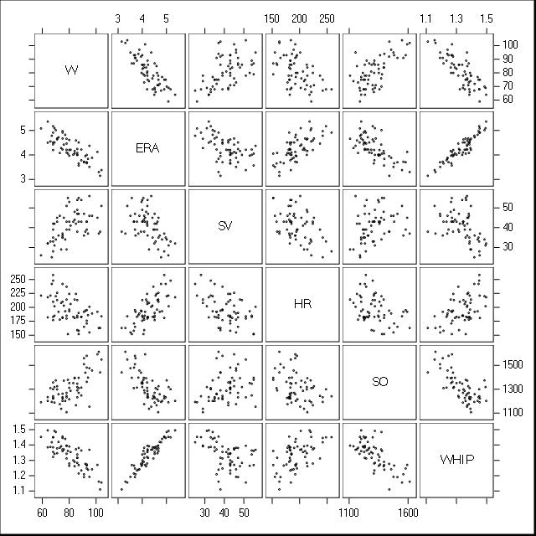
Scatterplot Matrix
All relationships with W seem to be fairly linear.
Notice some possible linear relationships between explanatory variables.
Multicollinearity could definitely be an issue between ERA and WHIP.

Slide 7
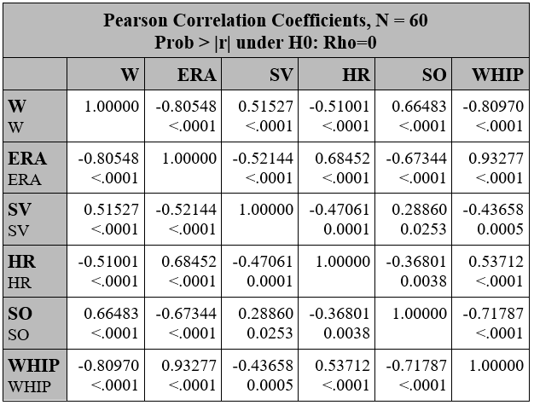
Correlation Matrix
Indicator for multicollinearity

Slide 8
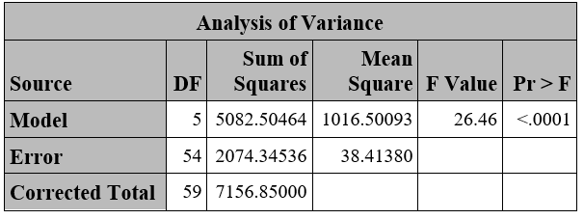
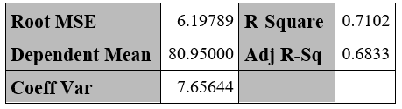
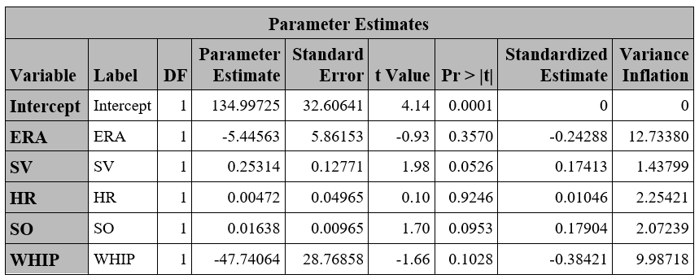
ANOVA and Parameter Estimates - Model I
The five variable model is significant overall based on our P-value, but the individual P-values do not look quite as good.
The Standardized Estimates bring the values to a much closer range.
VIF shows that ERA and WHIP may have some issues, but the rest look good.

Slide 9
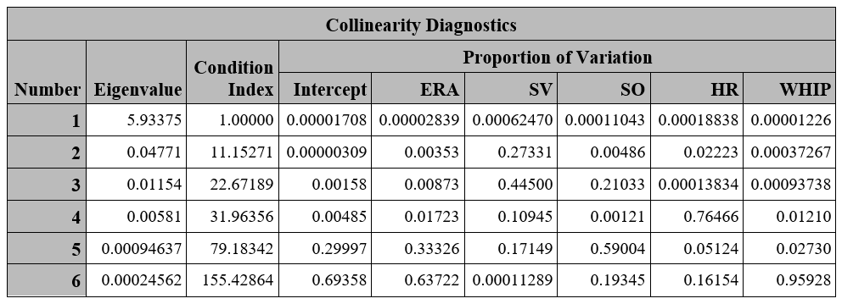
Collinearity Diagnostics
Intercept
ERA
SV
HR
SO
WHIP
Notes:
CI (>30: moderate multicollinearity; >100 severe multicollinearity problem)
Mutliple predictors have high proportion of variance (0.5) on these predictors with high CI

Slide 10
Model Selection
The next major operation we want to run was model selection.
This would allow us to see which model would work best, as we wanted to improve on our preliminary results.
Especially, we wanted to see if we could lower some of our VIF’s and if removing either ERA or WHIP would improve the model.
We ran a model selection on our main MLR model, looking at the three best options at each variable level.

Slide 11
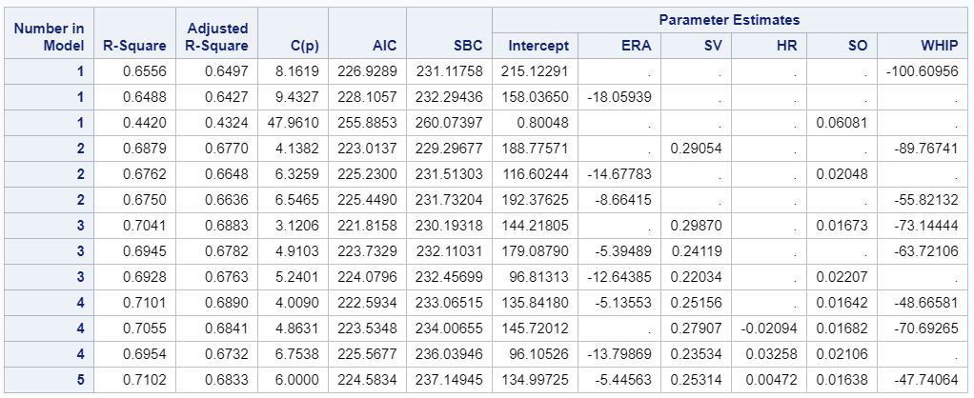
Model Selection

Slide 12
Stepwise Model Selection Method
Summary of Stepwise Selection
Step | Variable Entered | Variable Removed | Label | Number Vars In | Partial R-Square | Model R-Square | C(p) | F Value | Pr > F
1 | WHIP |  | WHIP | 1 | 0.6556 | 0.6556 | 8.1619 | 110.42 | <.0001
2 | SV |  | SV | 2 | 0.0323 | 0.6879 | 4.1382 | 5.91 | 0.0183
3 | SO |  | SO | 3 | 0.0162 | 0.7041 | 3.1206 | 3.07 | 0.0854
Notes:
Matches what we chose from the best selection method

Slide 13
“Best” Model Selection Method
While the best 3 variable and best 4 variable model both seem to be good options, we decided on the 3 variable model.
Those three variables are SV, SO and WHIP.
Before we ran the 3 variable model, we were interested in seeing how our new model would change VIF, individual P-values and residual charts.

Slide 14
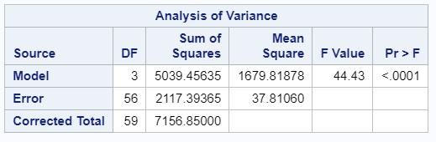

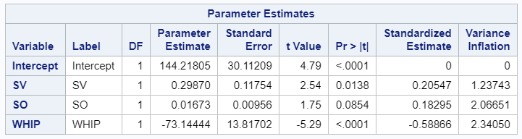
ANOVA and Parameter Estimates - Model II
R-Squared and Adjusted R-Squared both seem to be about the same as the full model.
Our main difference is the drastic decrease in the individual P-values and VIF values. The VIF changes seem to be due to the elimination of ERA, which is highly correlated with WHIP.

Slide 15
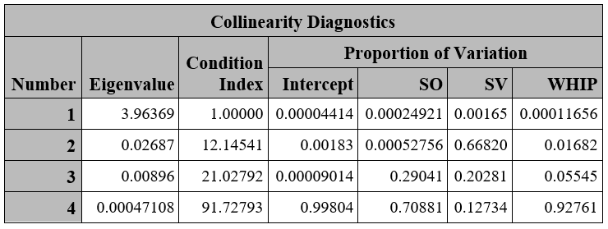
Collinearity Diagnostics - Model II
Notes:
Border between moderate and severe multicollinearity, leaving toward severe
Still have a bit of a problem for multicollinearity, but better than other models

Slide 16
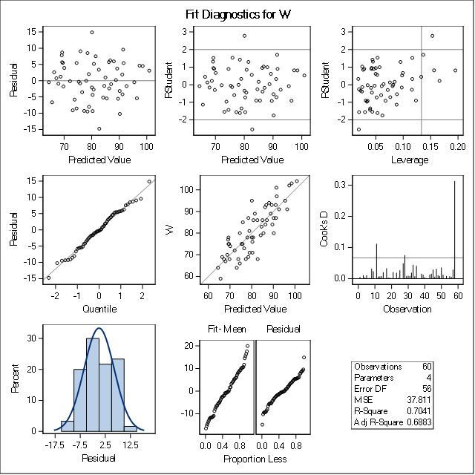
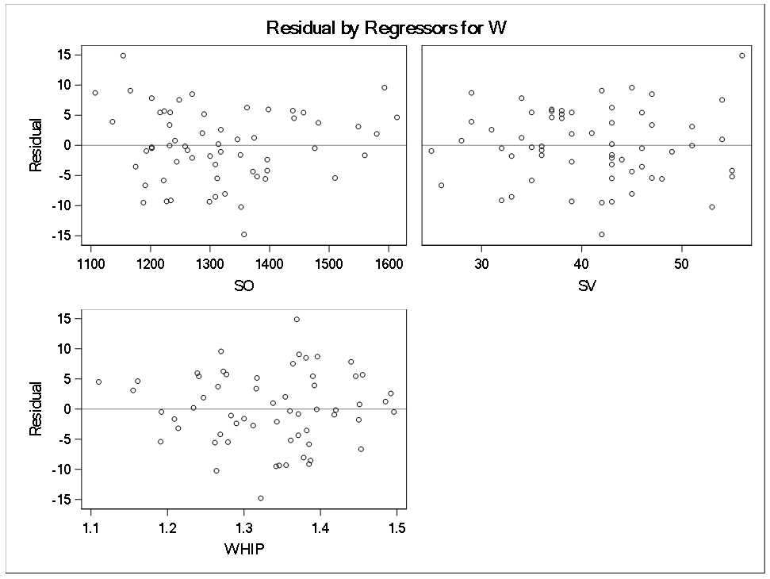
Residuals and Fit Diagnostics - Model II

Slide 17
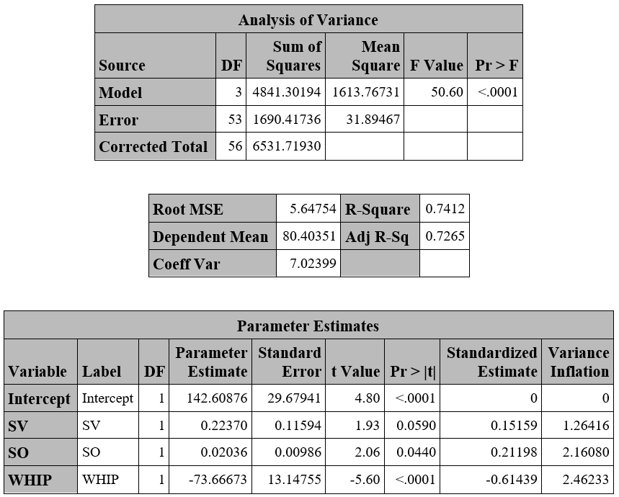
ANOVA and Parameter Estimates - Model III (Without Outliers)
When we removed 3 data values that we deemed to be outliers, our three variable model seemed to improve.
R-Squared and Adjusted R-Squared values some of the individual P-values improved.
Based on this information, we believe that the three data points removed were anomalies.

Slide 18
Testing
We decided to test our final model by inputting data from past seasons, and seeing if our model could predict what actually happened.
St. Louis Cardinals 2014:
Predicted Wins: 88.92 +- 12.9094 (95% CL Predict)
Actual Wins: 90
Kansas City Royals 2012:
Predicted Wins: 72.58 +- 12.3880 (95% CL Predict)
Actual Wins: 72

Slide 19
Conclusion
While ERA and WHIP are more correlated to Wins then the others, both together do not result in a better model.
HR (given up) are not as important in winning games as we thought going in to the tests.
Final Conclusion: As expected, team pitching seems to have a high correlation to the amount that a team wins.
Ŷ* = 0.15159(SV*) + 0.21198(SO*) - 0.61439(WHIP*)

Slide 20
References
baseball-reference.com

Slide 21
Questions?

